Slide 1
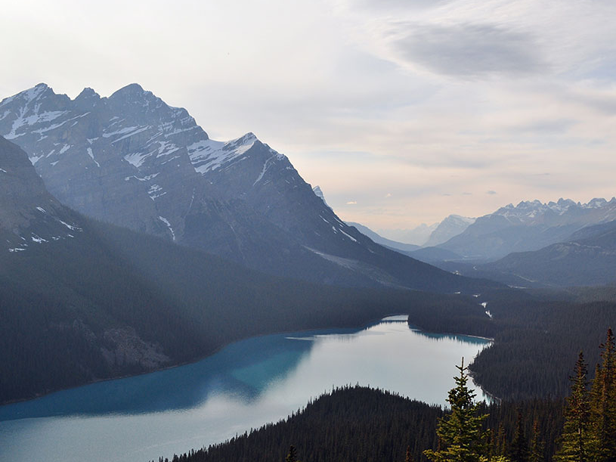

Deep Learning from Scratch
#ITSubbotnik 2016
28 May 2016

Slide 2
Agenda
Overview of concepts
Convolutional Neural Networks
Typical architectures
Use cases
Distracted Drivers Contest
Architecture design
Visualization of results
Questions

Slide 3
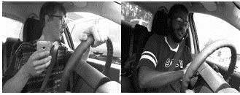
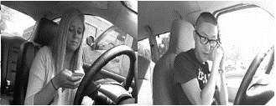

Distracted Drivers Contest
Can computer vision spot distracted drivers?
Competition by insurance company State Farm on Kaggle.com
dataset of RGB 640*480 camera images
22,424 train labeled images
79,726 test unlabeled images
classify each driver's behavior. Are they driving attentively, wearing their seatbelt, or taking a selfie with their friends in the backseat (10 target classes)
Logloss evaluation metric

Slide 4
Distracted Drivers Contest: Business Aspect
Benefits of improving pay-how-you-drive vehicle insurance models
customers
more affordable insurance for young drivers
better alignment of insurance with actual risk
society
more responsible driving
insurer
lower premiums even for rush hours/night typical driving
improved customer segmentation

Slide 5
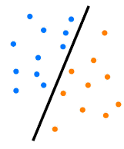
Classification in Machine Learning
Classification:
given training dataset, where inputs (x) are divided into several classes (y)
create a model which assign class to new unlabeled inputs
Approaches:
Traditional (regression, decision trees) = feature engineering + learning algorithm
Deep Learning = network with many layers + learning algorithm

Slide 6
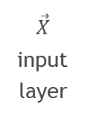
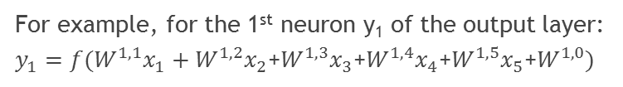
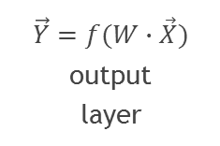
Neural Net without Hidden Layers
x₁
Matrix of weights W
Key features:
Layers consist of neurons
Full pairwise connection between layers
Each neuron transforms input to output
Matrix W describes linear transformation of input values
Activation functions f add nonlinearity to output
x₂
x₃
y₁
x₄
y₂
x₅
x₀ = 1 bias
$$\vec{X}$$ input layer
$$\vec{Y}=f(W∙\vec{X})$$ output layer
For example, for the 1st neuron y₁ of the output layer:
$y_{1}=f(W_{ }^{1,1}x_{1}+W_{ }^{1,2}x_{2}$+$W_{ }^{1,3}x_{3}$+$W_{ }^{1,4}x_{4}$+$W_{ }^{1,5}x_{5}$+$W_{ }^{1,0})$

Slide 7
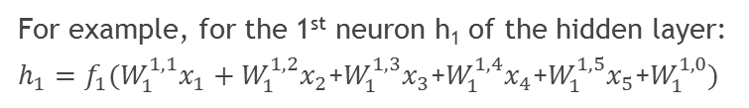
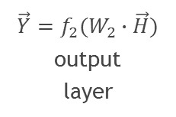
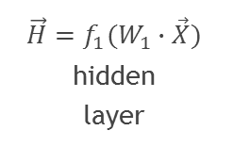
Neural Net with One Hidden Layer
W₁
W₂
x₁
h₁
Key features:
Full pairwise connection between adjacent layers
Matrices W₁ and W₂ describe linear transformations of features
Activation functions f₁ and f₂ add nonlinearity
Hidden layer creates features
x₂
x₃
y₁
x₄
y₂
x₅
x₀ = 1 bias
$$\vec{X}$$ input layer
$$\vec{H}=f_{1}(W_{1}∙\vec{X})$$ hidden layer
$$\vec{Y}=f_{2}(W_{2}∙\vec{H})$$ output layer
For example, for the 1st neuron h₁ of the hidden layer:
$h_{1}=f_{1}(W_{1}^{1,1}x_{1}+W_{1}^{1,2}x_{2}$+$W_{1}^{1,3}x_{3}$+$W_{1}^{1,4}x_{4}$+$W_{1}^{1,5}x_{5}$+$W_{1}^{1,0})$

Slide 8
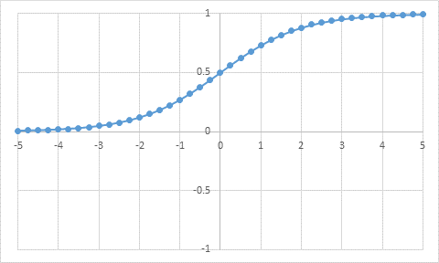
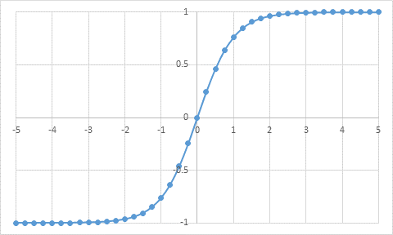
Activation Functions (1990s)
Sigmoid
f(x) = 1/(1 + exp(-x))
Values between 0 and 1
Continuously differentiable
Saturates at high values of |x|
Slow learning
Than
f(x) = 2*sigmoid(2*x)-1
Zero-centered adjustment of Sigmoid
Faster learning

Slide 9
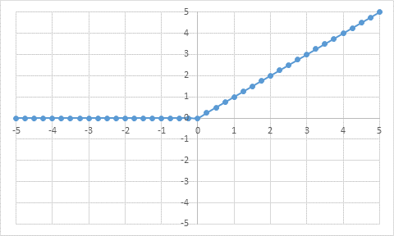
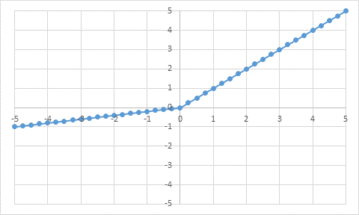
Activation Functions (2000s)
Rectified Linear (ReLU)
f(x) = max(0, x)
~ 5 times faster convergence of SGD than sigmoid
Some neurons “die” during training (activation is 0 for any input)
Leaky ReLU
f(x)=(x<0)(αx)+(x>=0)(x) where α is a small constant
Attempt to fix “death” of neurons in ReLU
At expense of additional parameter α to tune

Slide 10
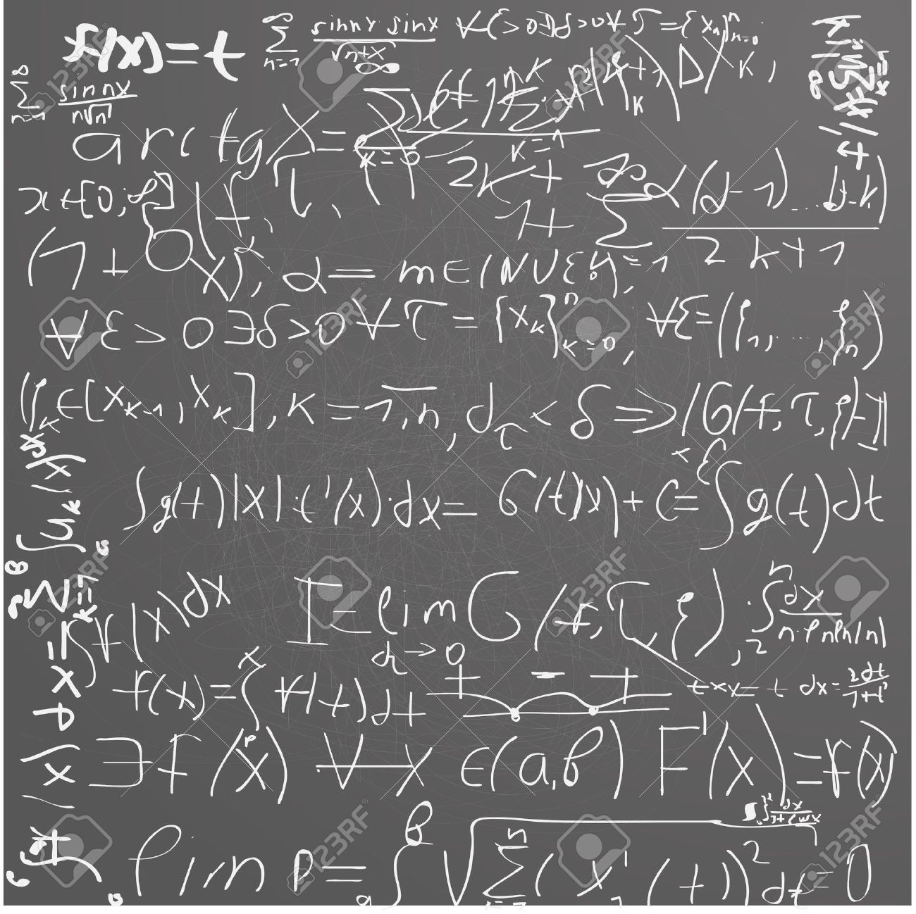

Learning Algorithm
Neural Networks training: find weights W to minimize loss function
Backpropagation – calculation of gradient of loss function with respect to weights W
Optimization methods use the gradients to update weights W
Backpropagation
gradients are computed for each layer using chain rule
errors are back propagated from output layer
Optimizers:
Gradient descend, with or without momentum
AdaGrad, RMSProp, Adam
→ Tools for automation of all calculations on slide 20

Slide 11
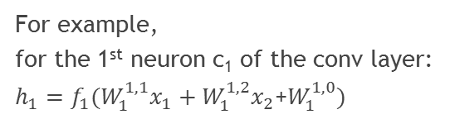
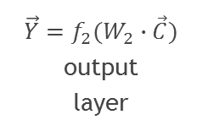
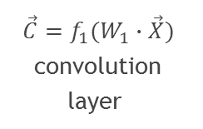
Network with Convolution Layer (1D)
W₁
W₂
Compared to fully connected layer:
Local connectivity – each neuron has limited receptive filed
Convolution layer consists of one or several feature maps
Weights sharing – all neurons of the feature map have the same weights
Consequently,
Less weights to learn
Features are extracted from any position on input layer
One set of weights correspond to one extracted feature
x₁
c₁
x₂
x₃
y₁
x₄
y₂
x₅
x₀ = 1 bias
$$\vec{X}$$ input layer
$$\vec{C}=f_{1}(W_{1}∙\vec{X})$$ convolution layer
$$\vec{Y}=f_{2}(W_{2}∙\vec{C})$$ output layer
For example, for the 1st neuron c₁ of the conv layer:
$h_{1}=f_{1}(W_{1}^{1,1}x_{1}+W_{1}^{1,2}x_{2}$+$W_{1}^{1,0})$

Slide 12
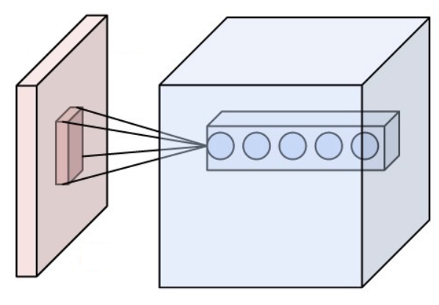
Network with Convolution Layer (2D)
Input layer (image) has three dimensions: height, width and number of channels (3 for RGB, 1 for grayscale)
Convolution layer has several (~ 10 – 100) feature maps
Number of neurons (height*width) of feature maps of the first layers typically equals image resolution
Every neuron of the feature map is connected with its receptive field only (all the channels)
receptive field
input layer
convolution layer of 5 feature maps

Slide 13
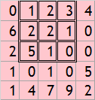


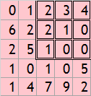

Layer Types: Convolutional
Feature map neuron = sum(mask*receptive field)
Shrinkage in size (feature map vs. previous layer) with increase in mask size and stride
Each feature map requires 3x3x1 + 1 = 10 weights to learn
4 hyper-parameters to tune:
Number of feature maps
Size of the receptive field
Size of stride
Padding amount (see the next slide)
Receptive field 3x3, stride 1x1, no bias
input
feature map
mask
Receptive field 3x3, stride 2x2, no bias
input
feature map
mask

Slide 14
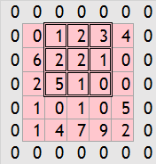
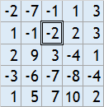
Layer Types: Padding
padding with zeroes
Can be thought of as an additional layer
Pads previous layer with zeroes
Prevents shrinkage which occurs after conv layers and allows stacking of multiple conv layers
Prevents underrepresentation of the borderline neurons of the previous layer
No weights to learn
1 hyper-parameter to tune:
Padding amount (how many rows of zeroes to add)
input
feature map
mask

Slide 15


Layer Types: Pooling
Pooling neuron = aggr_function(receptive field)
Shrinkage in size (pooling vs. previous layer) with increase in receptive field size and stride
Shrinkage is a desired feature. Typically padding is not used before pooling
No weights to learn
3 hyper-parameters to tune:
Size of the receptive field
Size of stride
Type of aggregate function (MAX is preferred)
Receptive field 3x3, stride 1x1
input
max pooling
aggregate function MAX
Receptive field 3x3, stride 2x2
input
average pooling
aggregate function AVG

Slide 16
Typical Architecture
INPUT -> [[CONV -> RELU]*N -> POOL?]*M -> [FC -> RELU]*K -> FC
Early convolutional layers extract basic features (e.g., lines, corners)
Convolutional layers are stacked one on the other
Padding is used to preserve the spatial resolution
Number of feature maps might increase in every next conv layer to construct more features of higher complexity
Pooling layer is optional. Useful to shrink the shape of feature maps and to add invariance to small translations of objects
Full connected layers are added in the end to combine complex features extracted from conv layers
Deeper networks, with more layers, are able to extract more complex features

Slide 17
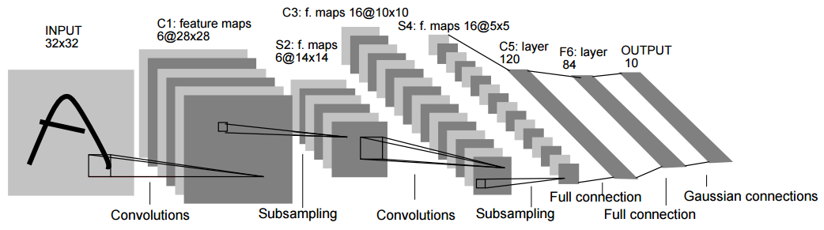
Architecture Example: LeNet-5 (LeCun, 1998)
The first successful application of Convolutional Networks
Was used to read zip codes, digits, etc.
2 Convolution layers, 2 Pooling layers, 3 fully connected layers in the end
What is the size of the receptive field of the first convolution layer? (given 32x32 input and 28x28 feature map size)

Slide 18
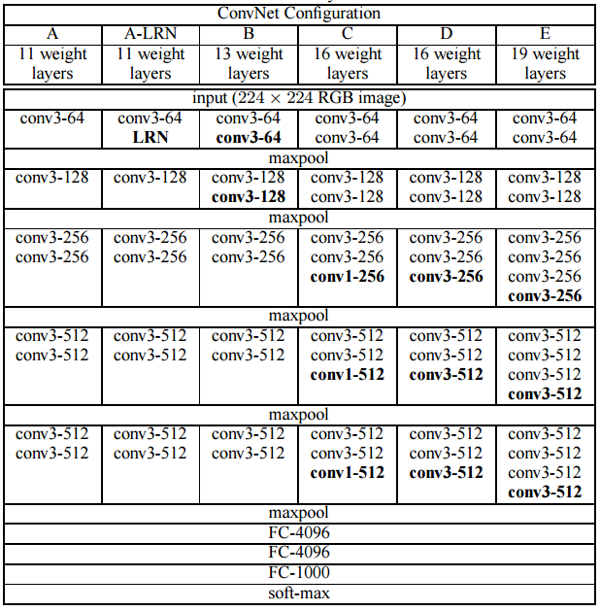
Architecture Example: VGGNet (2014)
2nd place on ImageNet Challenge 2014
Classification of 224x224 images
1K object classes, 1.4M images
16 Convolution layers (up to 512 feature maps)
5 Max Pooling layers
3 fully connected layers in the end (~1k neurons each)
144 000 000 parameters to learn

Slide 19
Layer Types: Dropout
Regularization technique
While training the neurons of the previous layer are kept active with probability p
On prediction phase dropout layers are switched off (!)
No weights to learn
1 hyper-parameter to tune:
Probability to keep neurons active
Dropout 20%
Dropout 50%
x₁
x₂
x₃
y₁
x₄
y₂
x₅
x₀ = 1 bias

Slide 20



Convolution Networks: Tools
Theano (Université de Montréal, 2007)
Tensor Flow (Google, 2015)
Features:
Calculation of derivatives
Fast evaluation of expressions
Python NumPy integration
Works on CPU, GPU, multiple GPUs
Open Source, active community
Keras runs on top of Theano or Tensor Flow
“The purpose of Keras is to make deep learning accessible to as many people as possible, by providing a set of "Lego blocks" for building Deep Learning models in a fast and simple way.” (blog.keras.io)

Slide 21
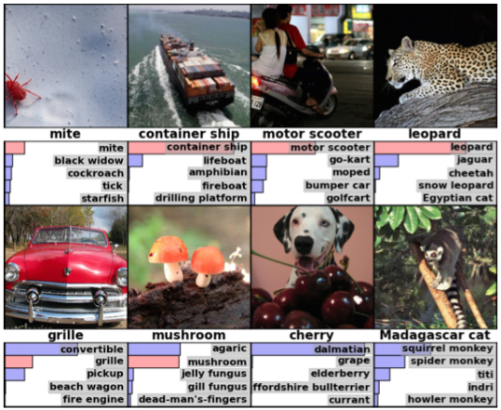
Convolution Networks: Use Cases
Image recognition
Facial recognition
Natural Language Processing (NLP)
Drug discovery (prediction of interaction between molecules and proteins)
Paying GO (AlphaGO)
Video analysis

Slide 22
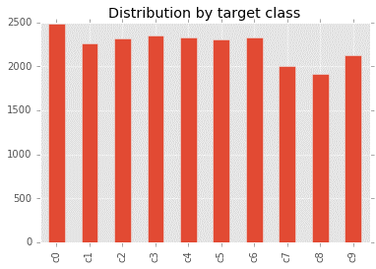
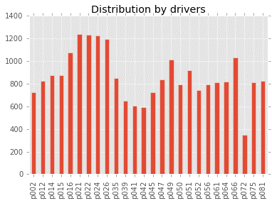
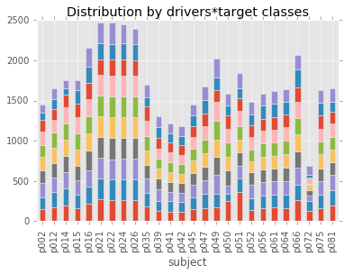
Distracted Drivers: Exploratory Data Analysis
10 target classes are well-balanced
There are 26 unique drivers in the training set
Drivers are not equally represented
Target classes are well-balanced by driver

Slide 23
Setup of Analytical Environment
Linux. Tensor Flow doesn’t support Windows
Anaconda (batteries included for python 2/3)
Good GPU will speed up training (optional)
Deep Learning tools:
Create and activate python virtual environment (optional)
pip3 install --upgrade https://storage.googleapis.com/tensorflow/linux/cpu/tensorflow-0.8.0-cp34-cp34m-linux_x86_64.whl
pip3 install theano keras h5py
Download IPython notebooks (optional):
git clone https://github.com/AntonP84/1605_Distracted_Drivers.git

Slide 24
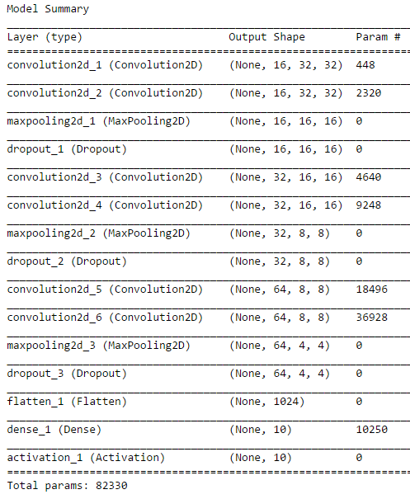
Architecture Design
Small scale VGGNet
INPUT -> [[CONV->RELU]*2 -> POOL]*3 -> FC
Regularization by Dropout layers
82,330 weights to learn
Note,
No additional FC layers in the end
With the increase of the layer’s depth
shape of feature maps is decreasing due to pooling (32x32 –> 16x16 -> 8x8 -> 4x4)
number of feature maps is increasing (16 -> 32 -> 64)

Slide 25
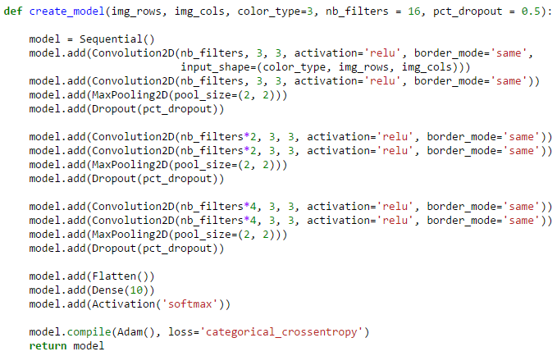
Architecture Design: Keras Code
Neural Networks prototyping in Keras is easy

Slide 26
Training Process and Results
Start KFold 2/5
Train drivers: ['p002', 'p012', 'p016', 'p021', 'p024', 'p026', 'p035', 'p039', 'p042', 'p045', 'p047', 'p049', 'p050', 'p051', 'p052', 'p061', 'p064', 'p066', 'p072', 'p075', 'p081']
Test drivers: ['p014', 'p015', 'p022', 'p041', 'p056']
Train on 18041 samples, validate on 4383 samples
Epoch 1/20
18041/18041 [==============================] - 159s – loss: 0.5948 - val_loss: 0.4218
Epoch 2/20
18041/18041 [==============================] - 156s – loss: 0.4532 - val_loss: 0.4199
Epoch 3/20
18041/18041 [==============================] - 155s – loss: 0.3859 - val_loss: 0.5418
Epoch 4/20
18041/18041 [==============================] - 157s – loss: 0.3363 - val_loss: 0.5068
early stopping
Prediction for the test dataset
79726/79726 [==============================] - 266s
Images are downscaled to 32x32
5-folds cross-validation on driver level
Adam optimization (default settings)
Early stopping if validation error is not decreasing for two consecutive epochs
→ In the end, we have 5 nets (one per each fold) which are combined with arithmetic average
Training time 15 minutes for all 5 folds
Logloss:
0.4384 on training set
0.5321 on validation set
0.8712 on test set (TOP 20% LB as of May 20)
No tuning of hyper-parameters

Slide 27
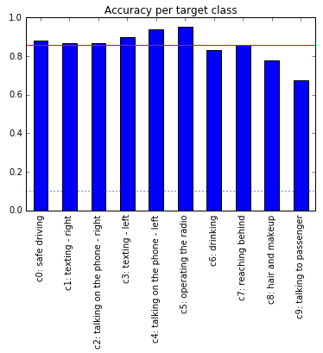
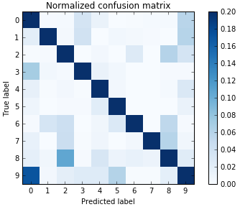
Model Diagnostic by Image Class
Model accuracy (share of correct predictions) is 85% vs. 10% for random guess
Issues to work on:
Accuracy for c9 class is below average
Seldom c9 class is misclassified as c0 class

Slide 28
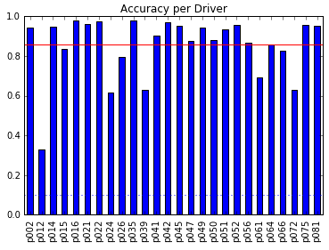
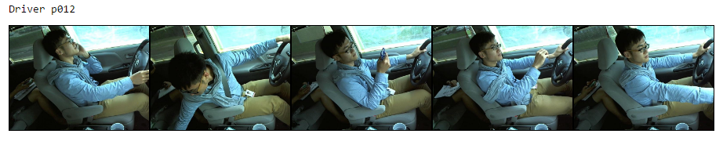
Model Diagnostic by Driver
Issues to work on:
Accuracy of classification for some drivers (e.g. p012) is well below average
Manually check images, investigate reasons, propose adjustments

Slide 29
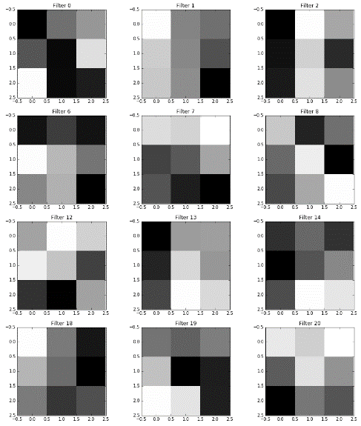
Visualization: Weights
Weights of the 1st convolution layer (one picture per feature map)
Receptive field 3x3
Each feature map extracts some basic feature (lines, corners)

Slide 30
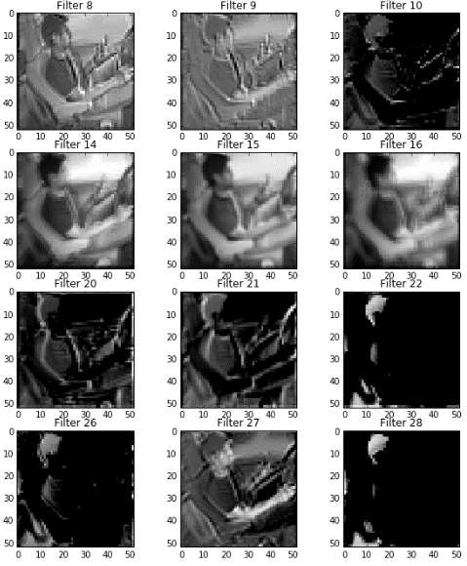
Visualization: Images
Image processed by the 1st convolution layer (one picture per feature map)
Size is kept the same 32x32
Images is smoothed by the kernel of the feature map

Slide 31
Takeaway Points
Neural Networks automatically learn and extract features
Convolutional Neural Networks are good for image recognition
Accuracy of state-of-art models exceeds human capabilities
Practical considerations:
For small datasets (~10k cases) modelling is easy even on desktops
For large datasets (~1M cases) modelling requires computing resources and data science expertise

Slide 32
Deep Learning from Scratch

